Slide 1

Practical Assignment: Software Testing and Quality for MERN, Spring Boot, or .NET Applications
INDUWARA K.M.W
EG/2022/5083

Slide 2
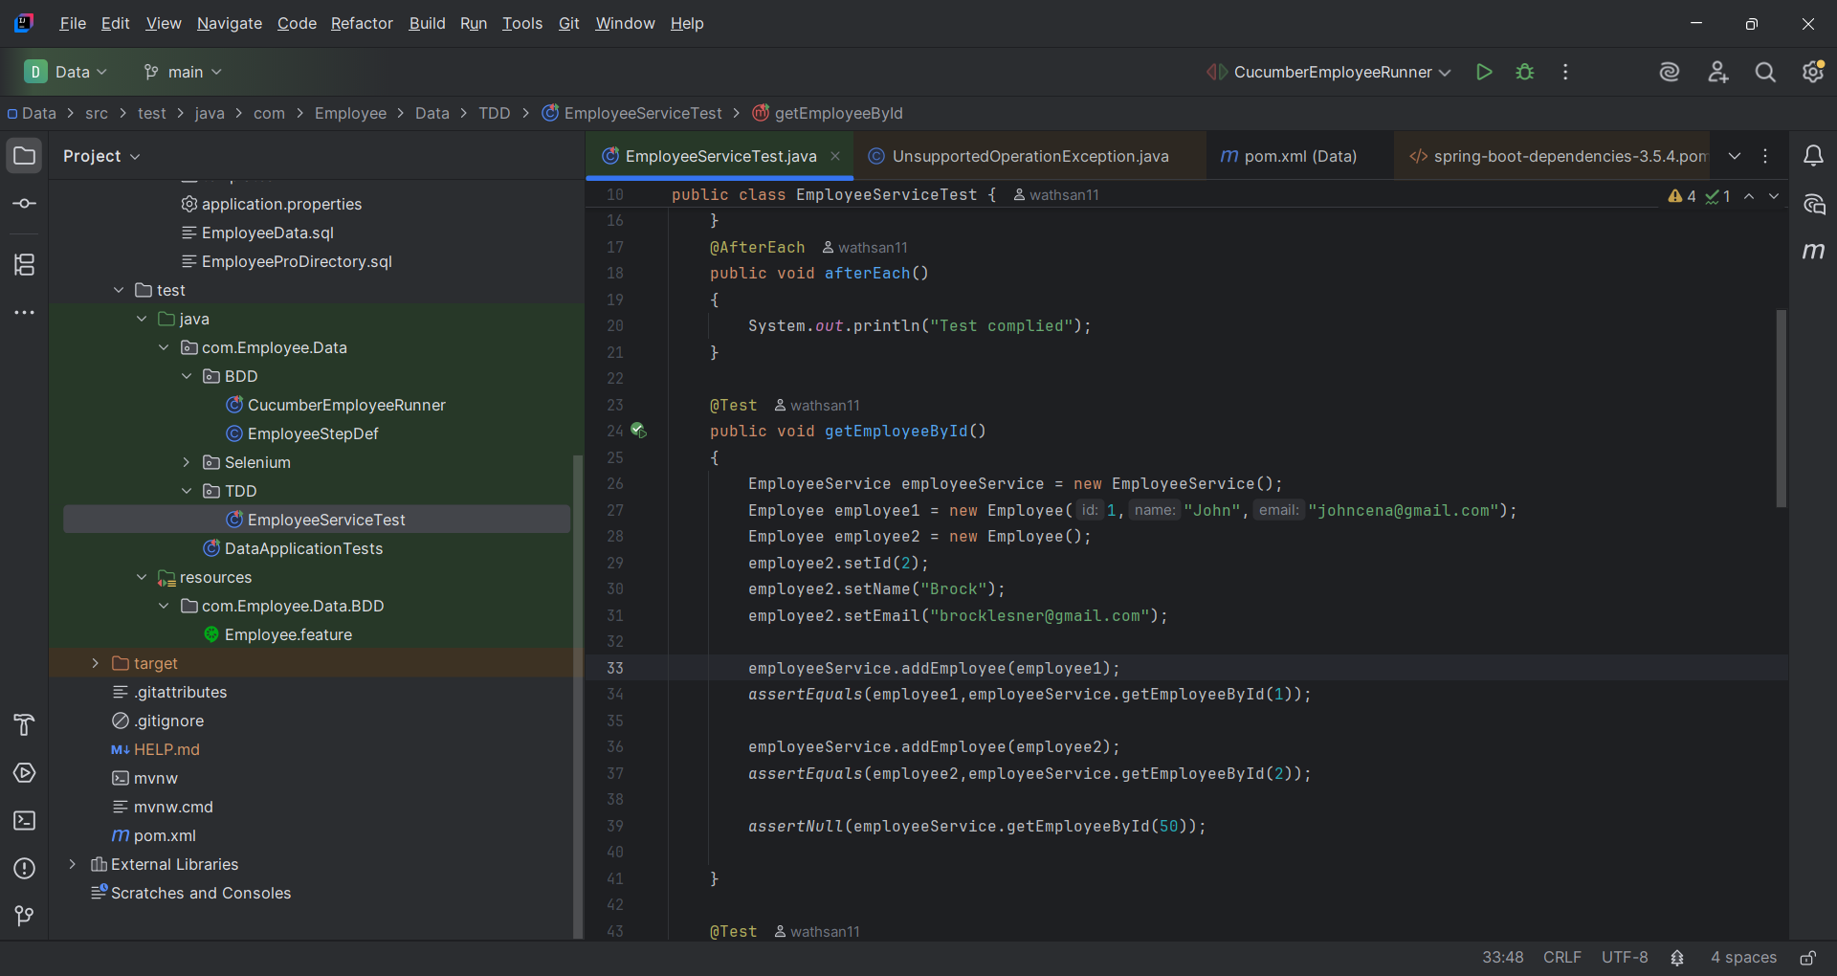
Test-Driven Development (TDD)
Unit Test

Slide 3
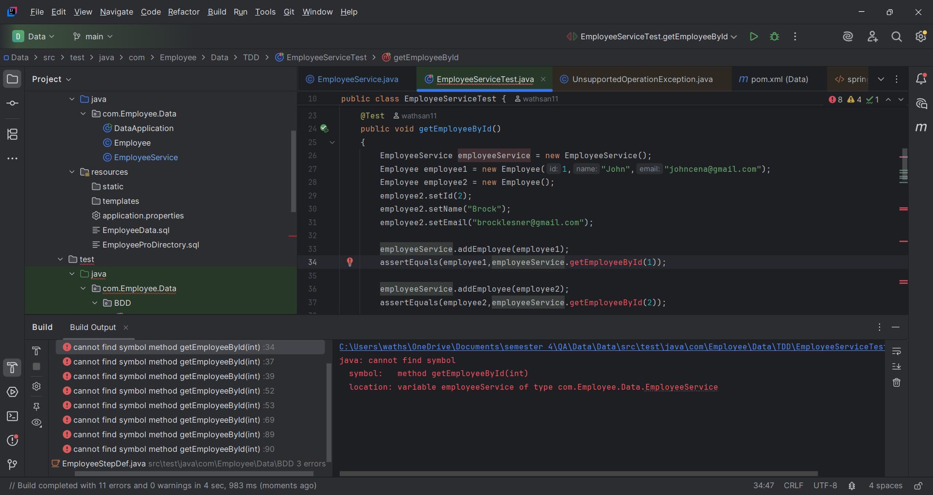
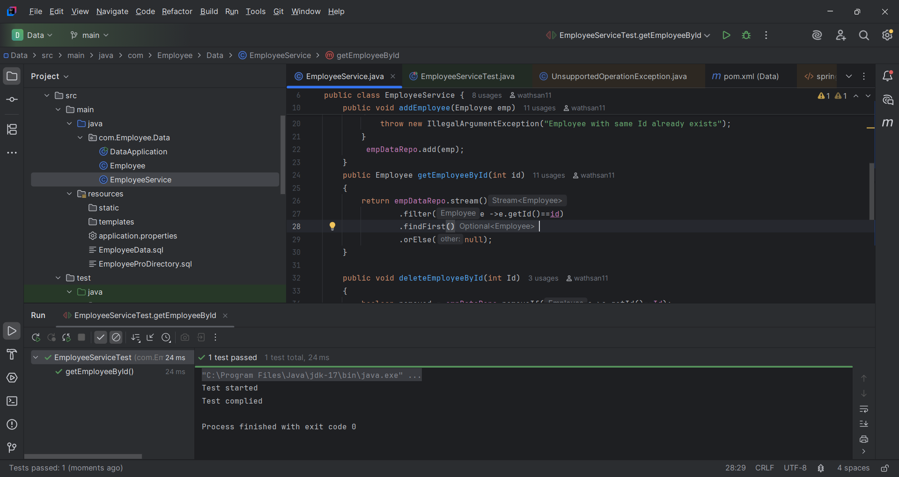
Failing test (Red).
Implement code to pass the test

Slide 4
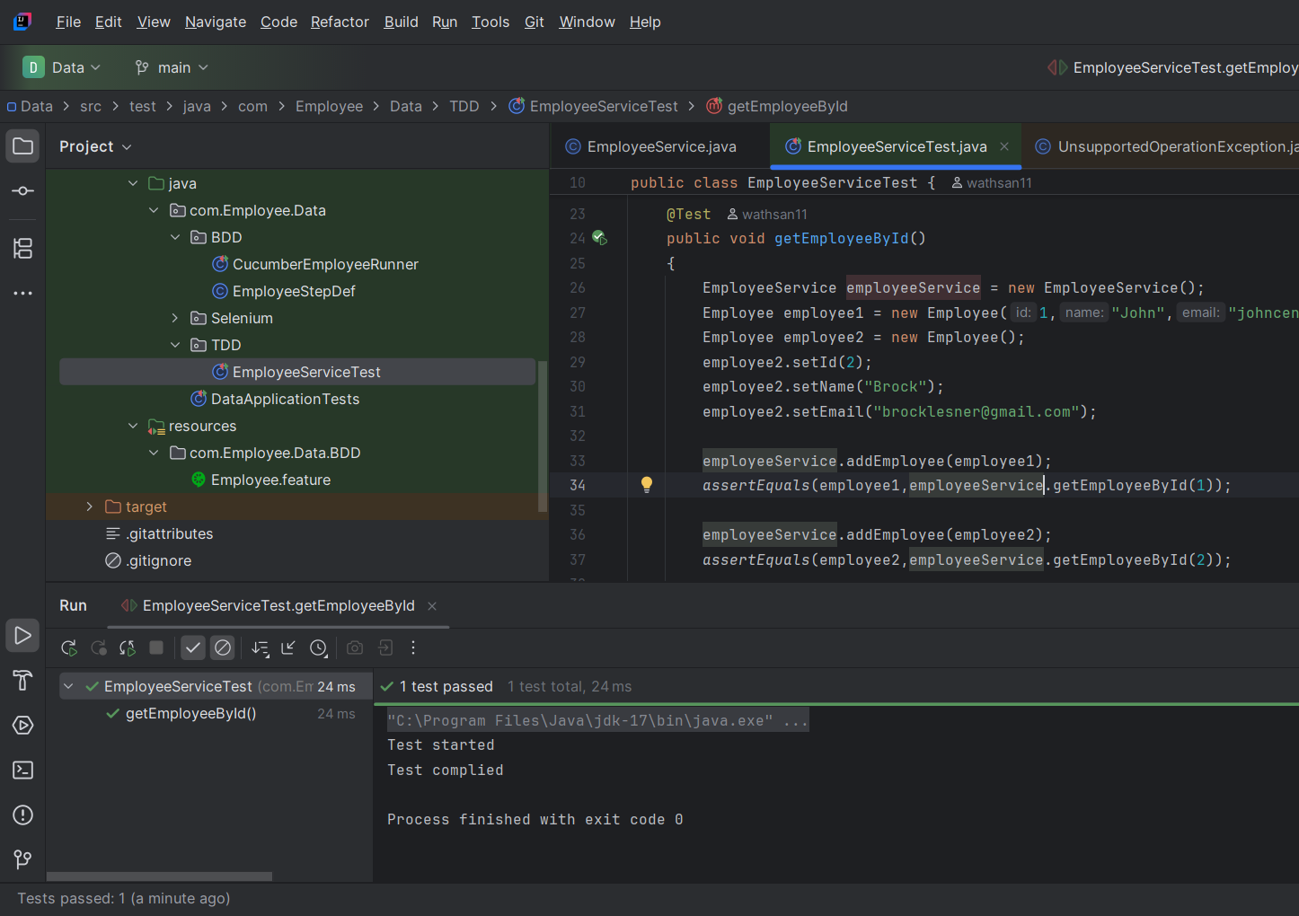
Pass the test (Green)

Slide 5
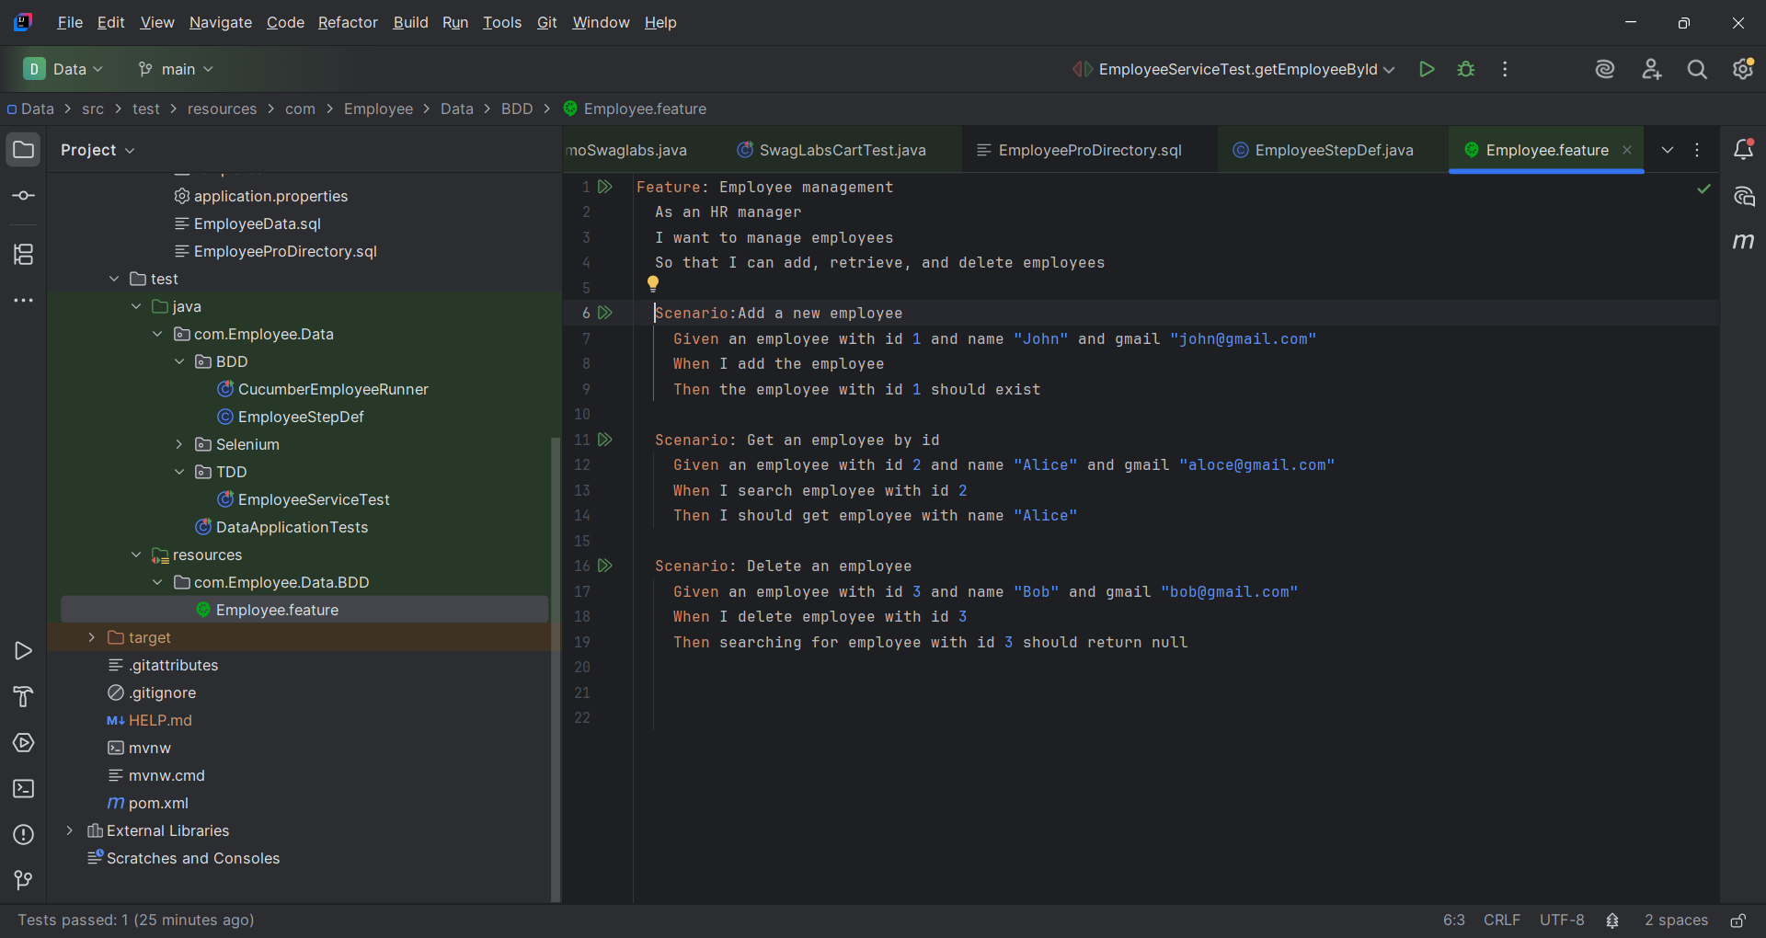
Behavior-Driven Development (BDD)
feature file in Gherkin syntax

Slide 6
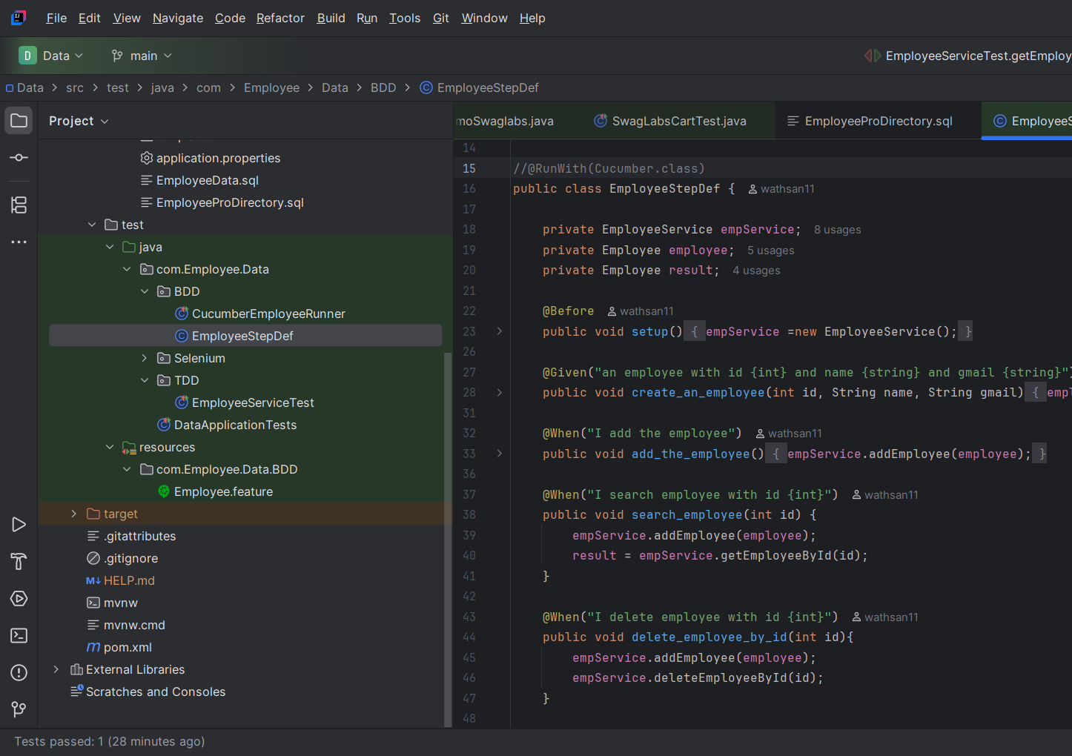
step definitions in Java with Cucumber

Slide 7
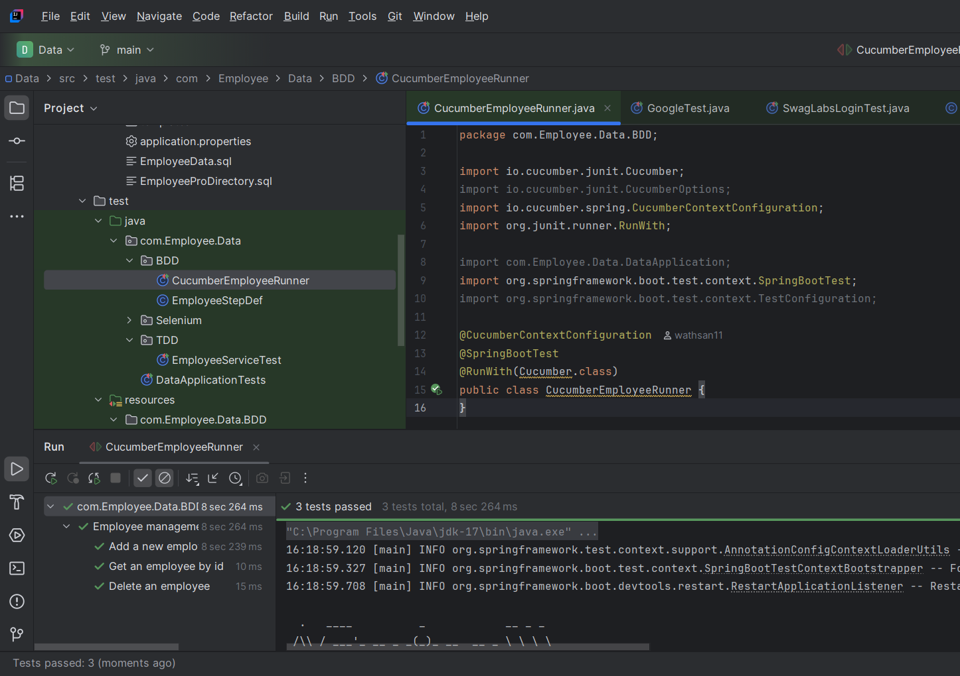
BDD tests

Slide 8
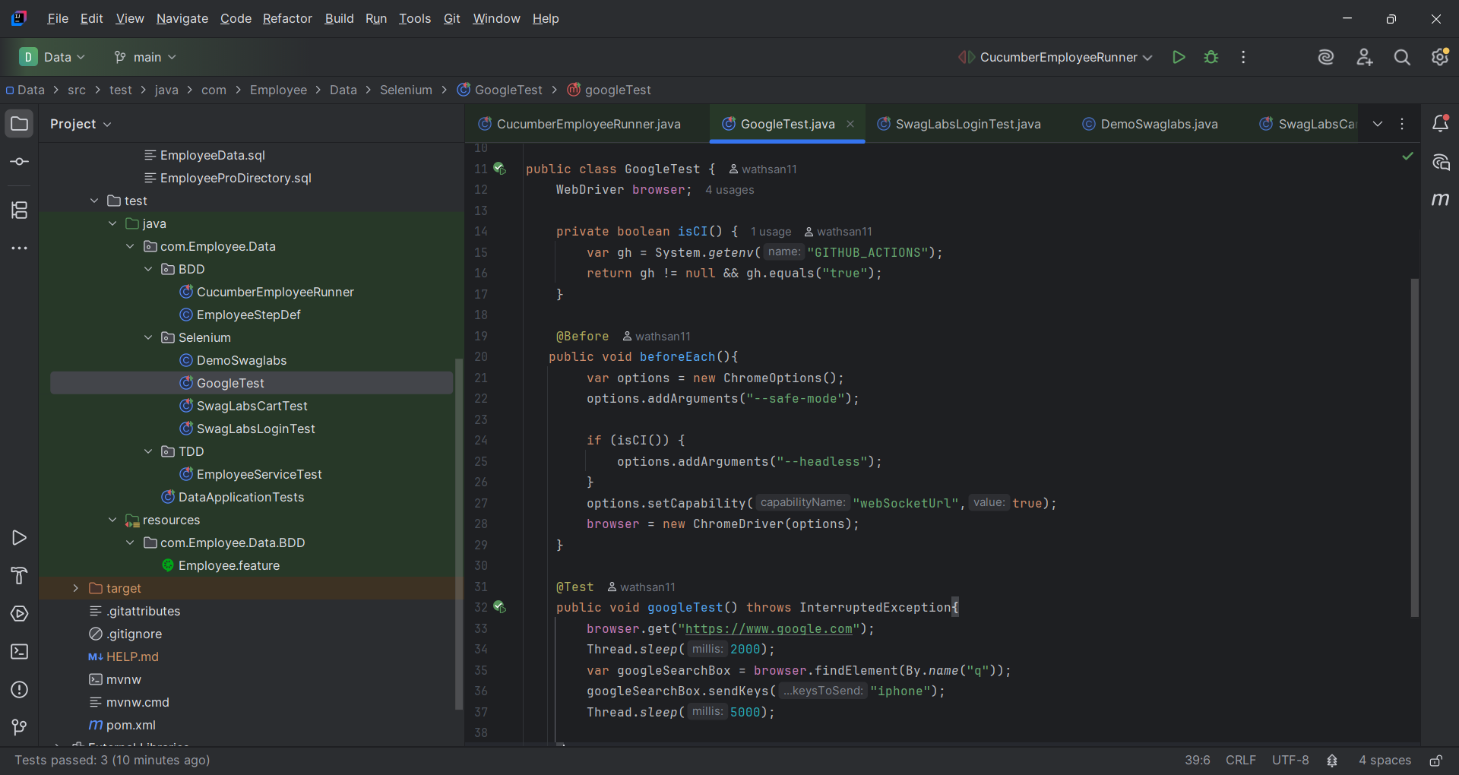
Test Automation & Continuous Integration
Selenium UI test scripts

Slide 9
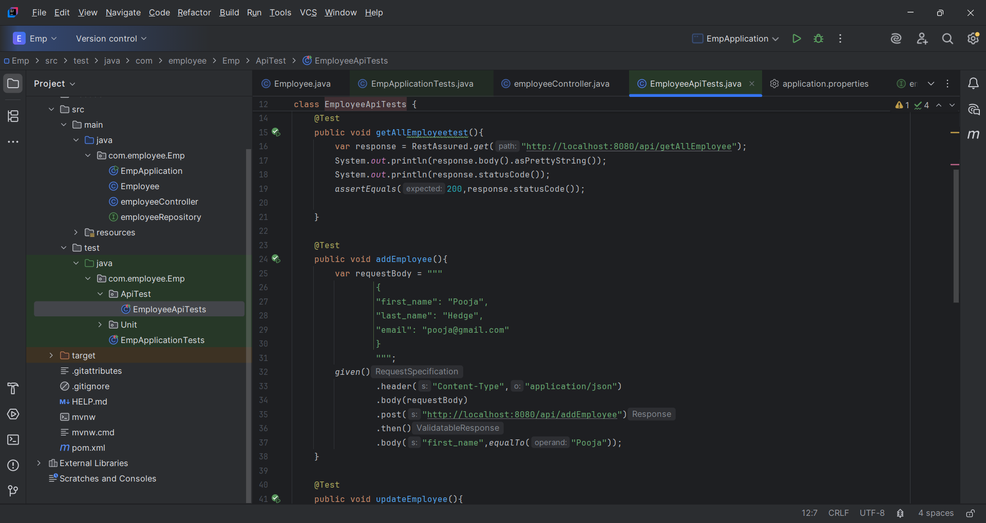
API test

Slide 10
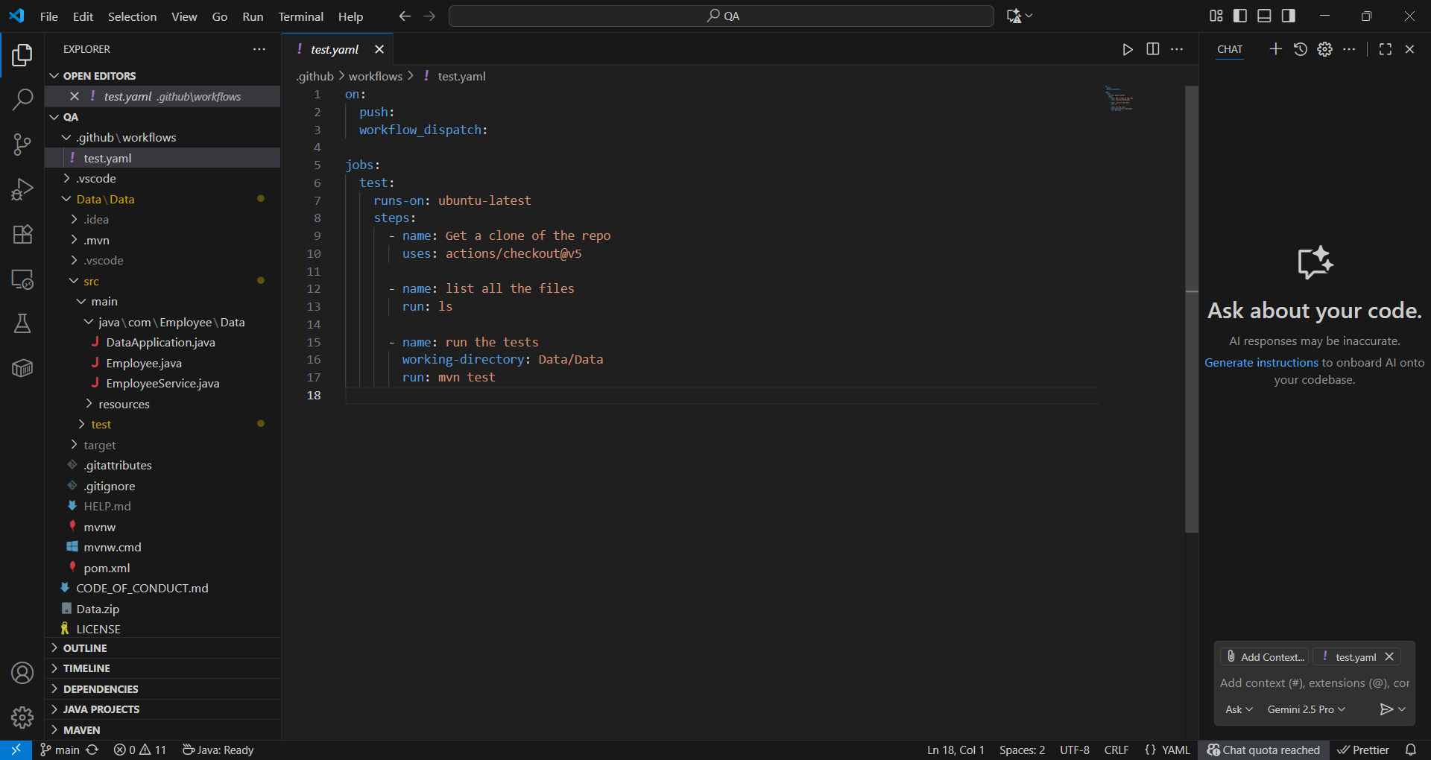
CI/CD pipeline using GitHub Actions
git commit --allow-empty -m "test"

Slide 11
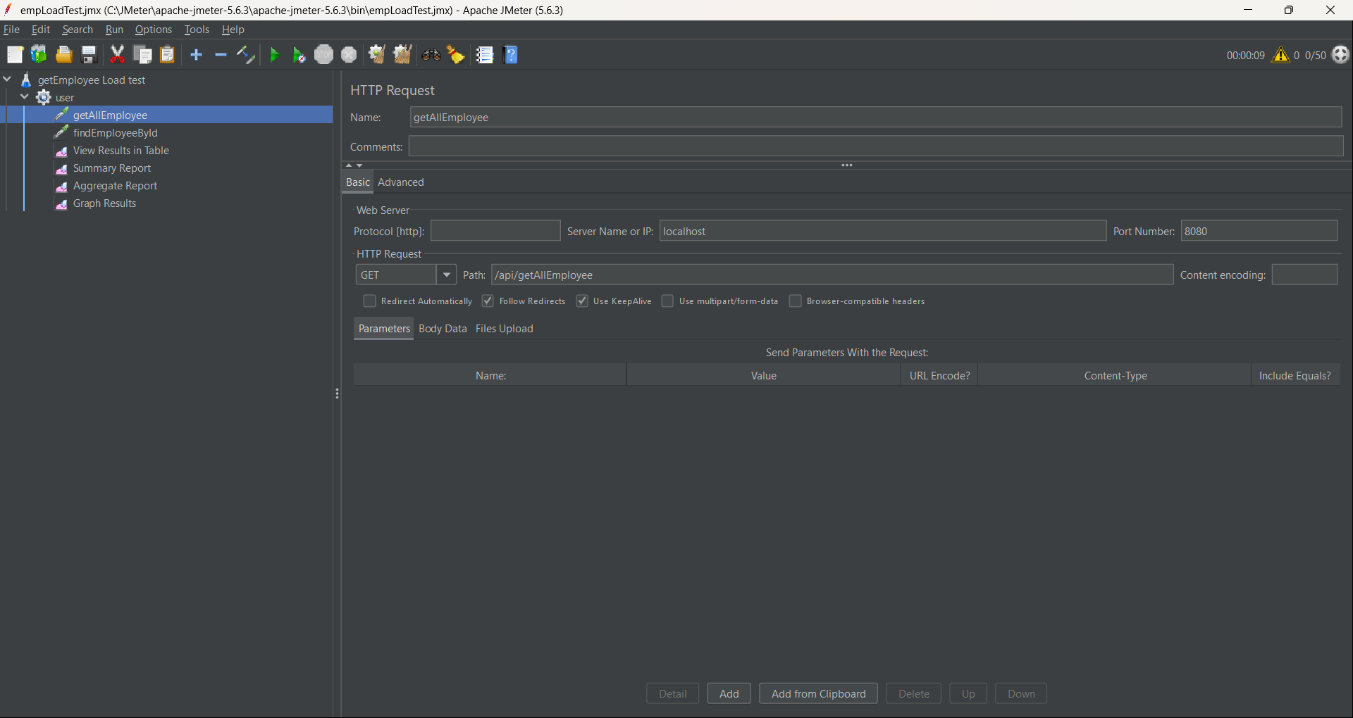
Performance, Security, and Usability Testing
Load Testing with JMeter

Slide 12
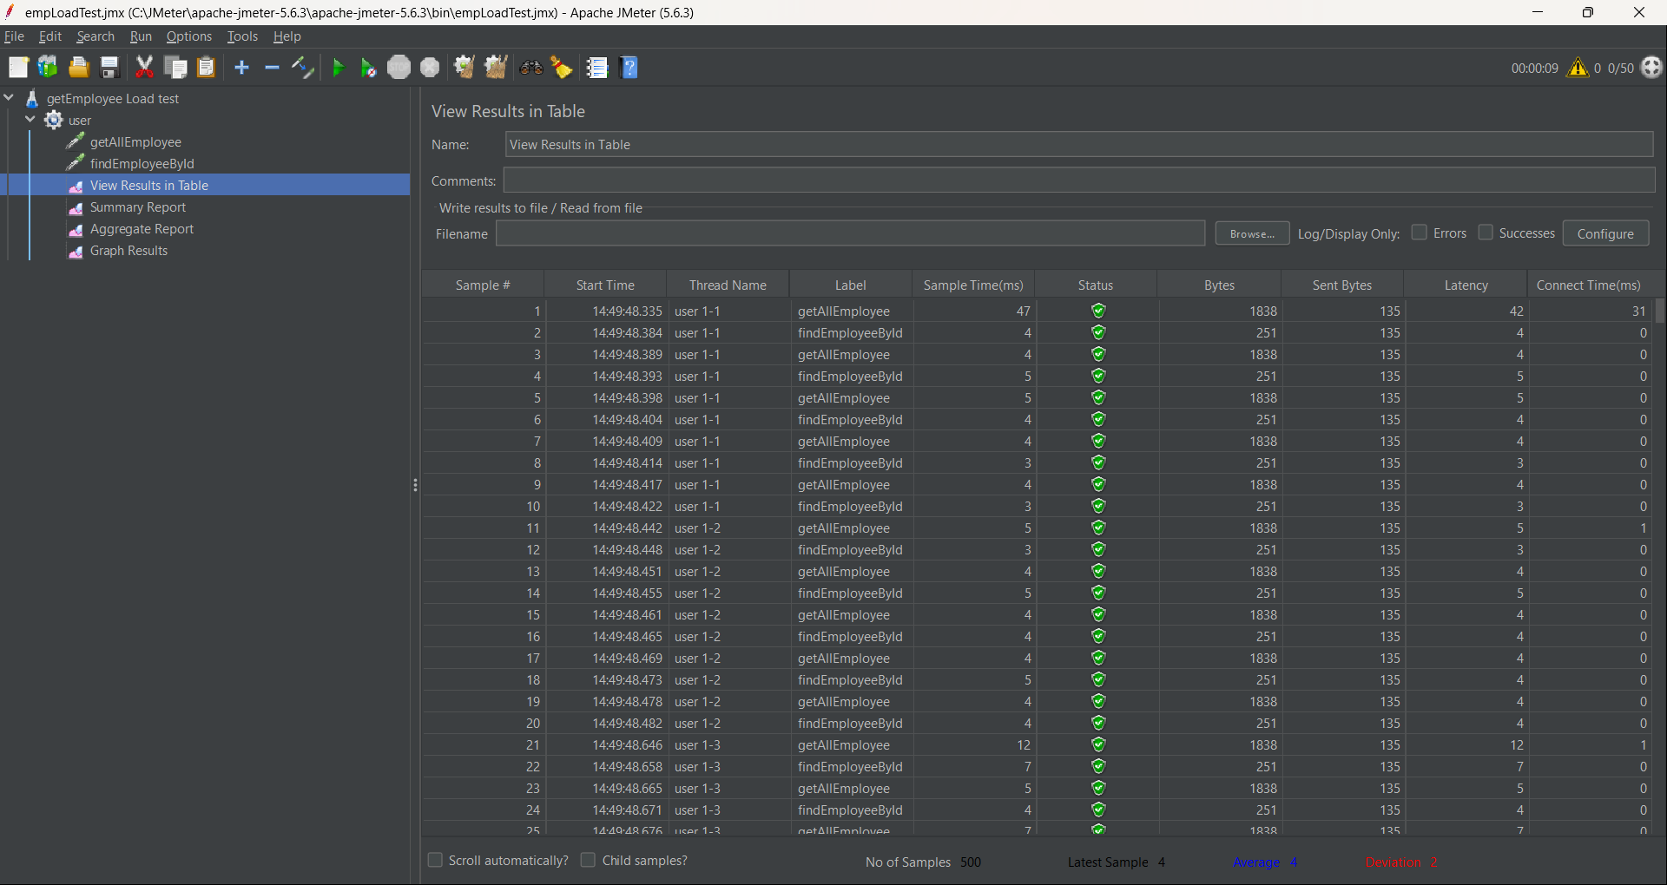
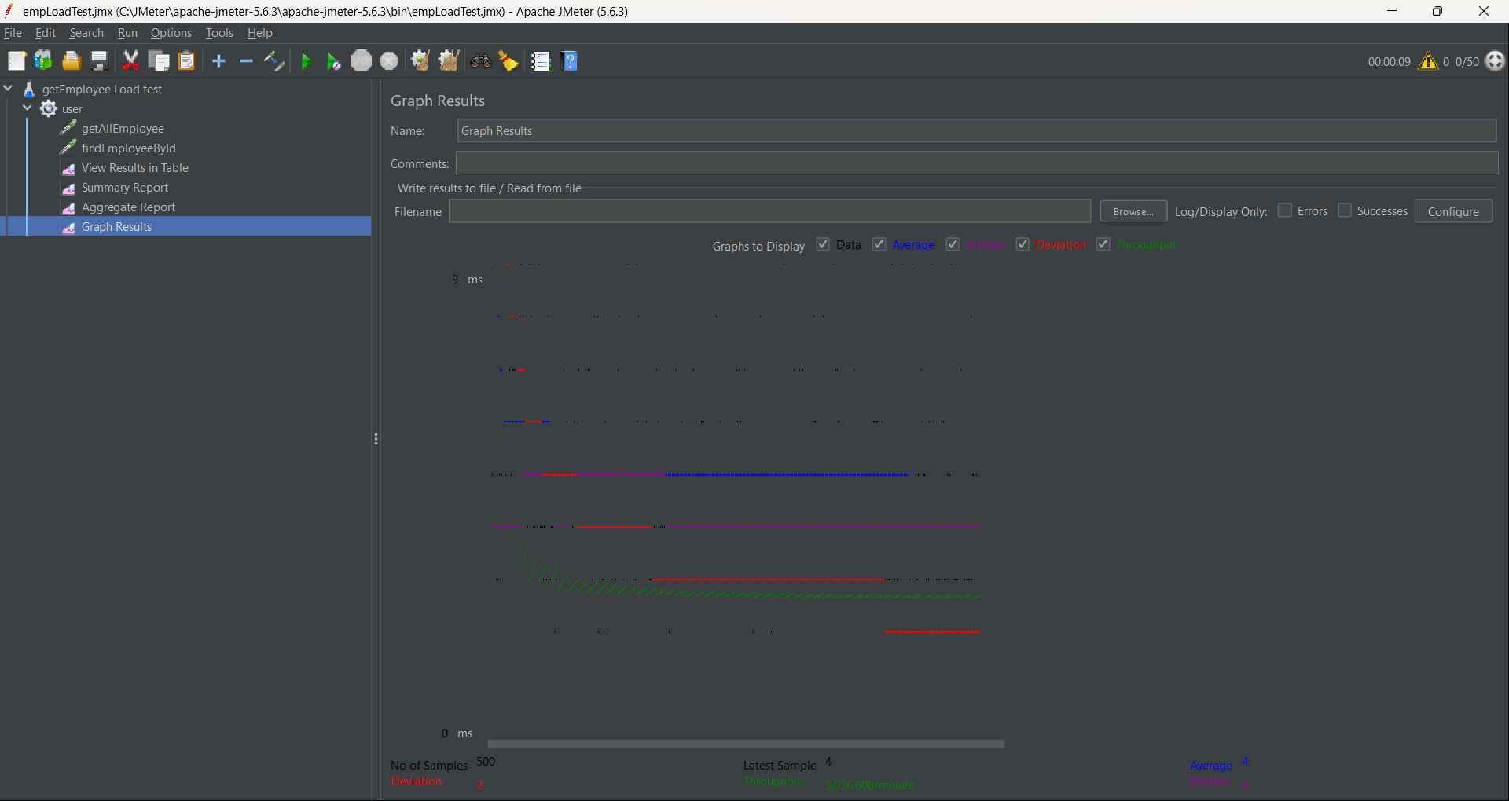

Slide 13
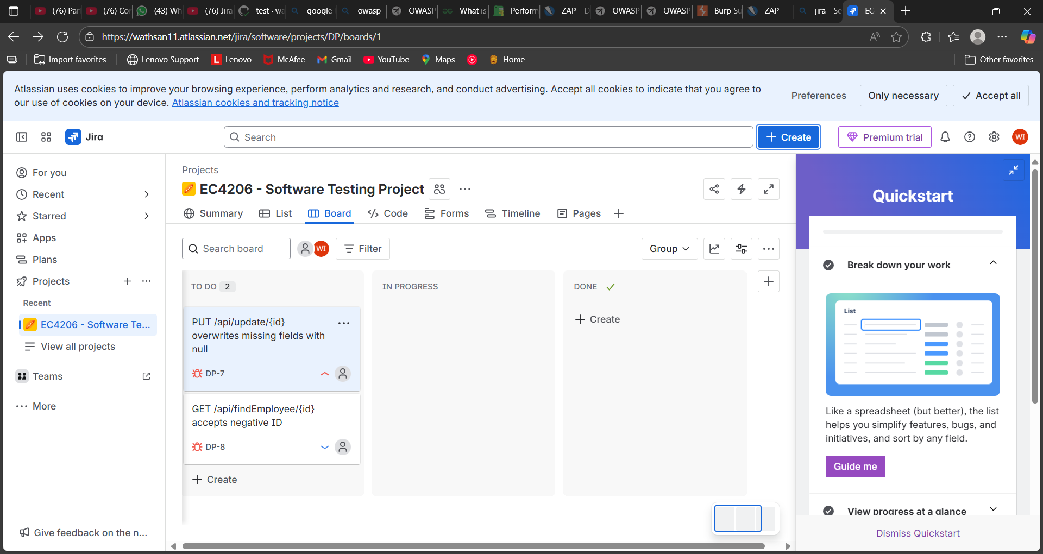
Defect Tracking and Bug Management
bugs found during testing

Slide 14
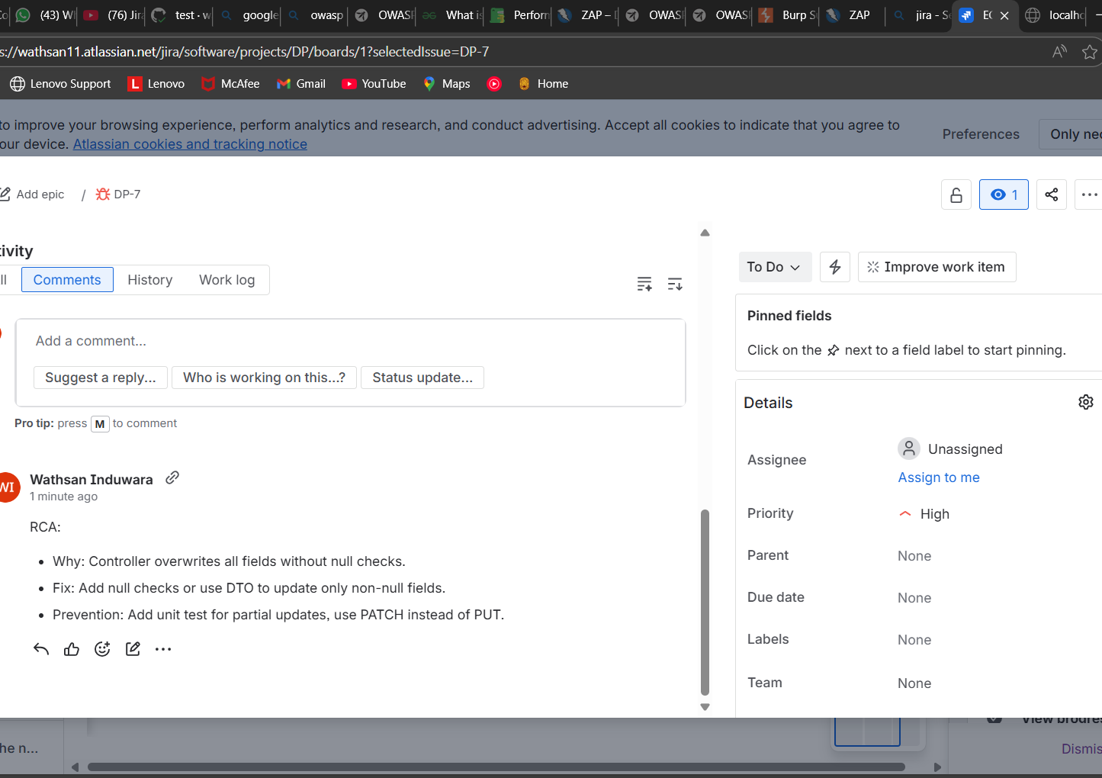
root cause analysis on a bug

Slide 15
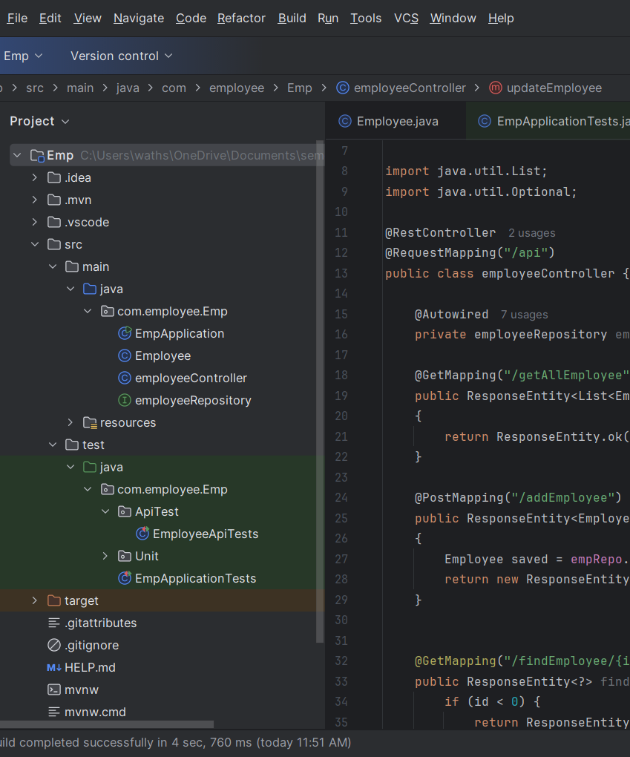
Software Quality Metrics and Standards
Defect Density -Number of defects per 1,000 lines of code
Lines of Code (LOC) = 65
Total Bugs = 2
Defect Density=Number of Defects/ Lines of Code (LOC)
=2/65
=0.031​​
31 defects/KLOC

Slide 16

Mean Time to Failure (MTTF) : Average operational time between inherent failures
MTTF = Total Operating Time / Number of Failures
= 1h/2
= 0.5 h/defect
MTTF

Slide 17
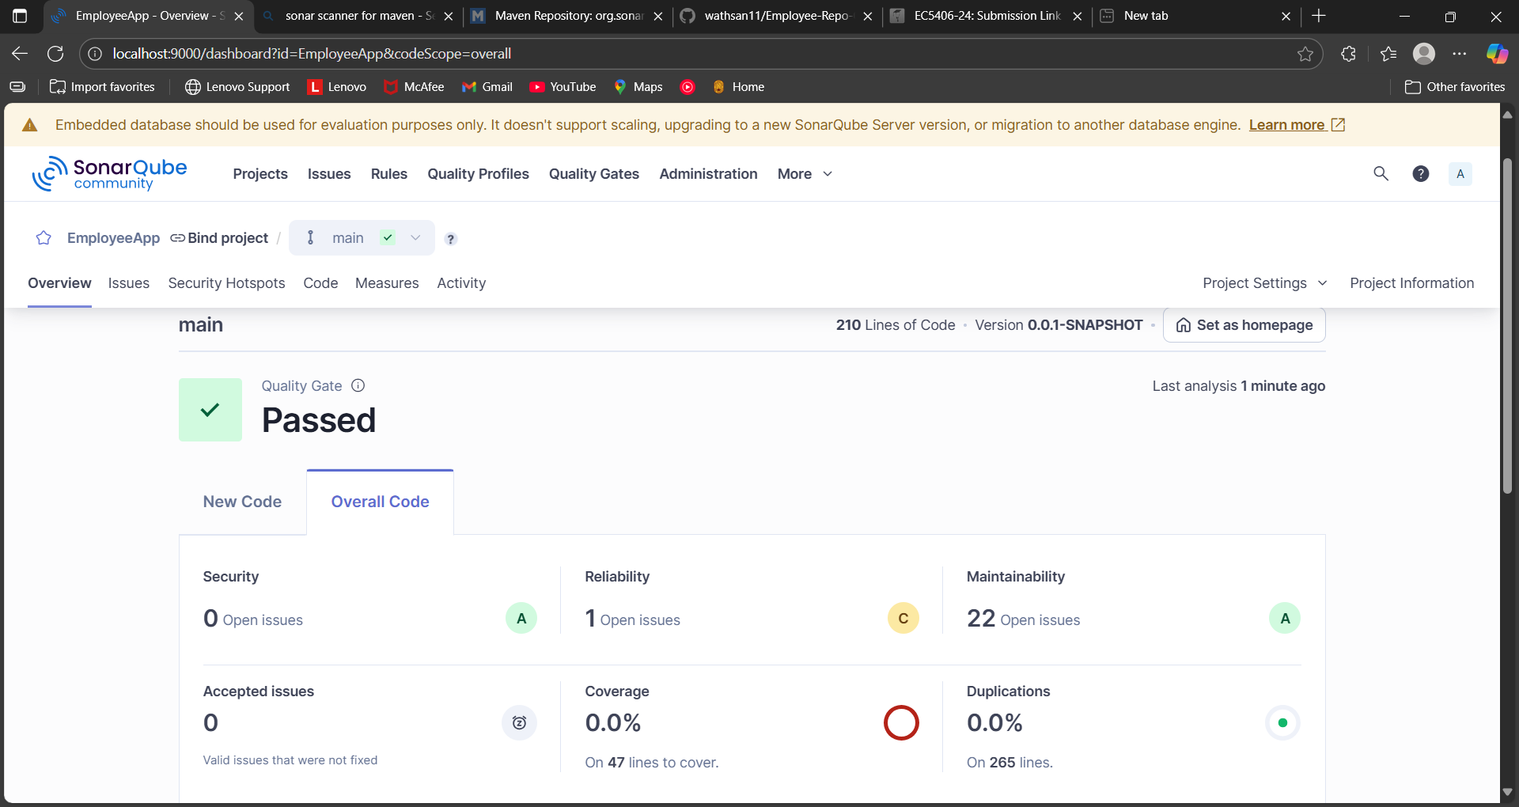
SonarQube Analysis
http://localhost:9000/
mvn clean verify sonar:sonar -DskipTests -Dsonar.projectKey=EmployeeApp -Dsonar.projectName=EmployeeApp -Dsonar.host.url=http://localhost:9000 -Dsonar.token=sqp_47b2044948c16e5fb26c1329a67f3f7d37b8338e

Slide 18
Thank You

